Slide 1
Peripheral Interfacing
Gurukul Smart Projetor ecosystem

Slide 2
Speaker connection
S/PDIF protocol for digital audio transfer
PCM coded signals will go to FPGA board
Power amplifier connection to speakers via RCA cables
Speaker requirements:
2.0 stereo speakers ( pair of 2)
8 ohm ( 4-16 ohm range max)
1W power
power amplifier( similar to LM4889 IC )
DAC requirements:
3.3V input voltage ( range -0.2V to 3.75V )
Max current flowing to speakers

Slide 3
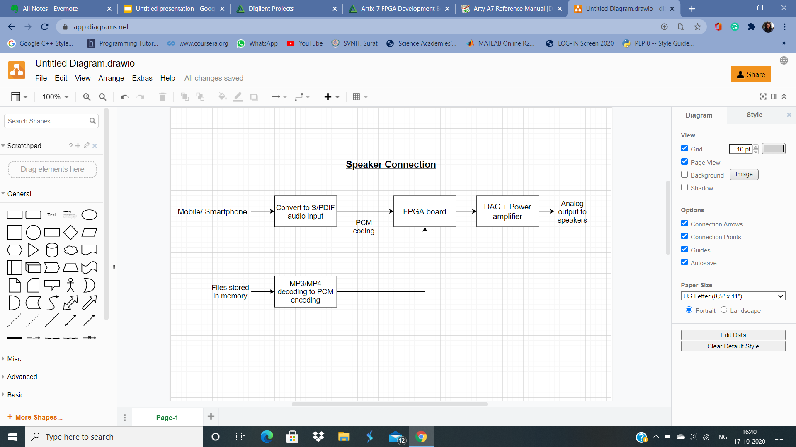
Basic Layout

Slide 4
Features
Pros:
Number of speakers can be increased ( in case of larger classrooms) as long as the total impedance of the stereo speakers remains in 4-16 ohm
Follows a similar approach of CS43L21 IC which is already tested.
Cons:
Timing of audio input and projector display need to be explicitly synchronised.

Slide 5
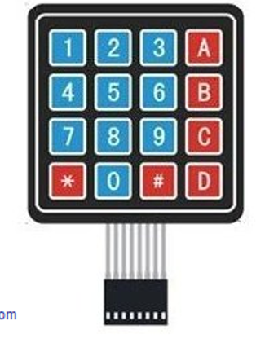
Keypad interfacing
4x4 matrix keypad mount on top of the projector
This will follow arduino - like connection, C module to define functions of every key.
8 GPIO pins
Minimal cost- around 100-200 rs

Slide 6
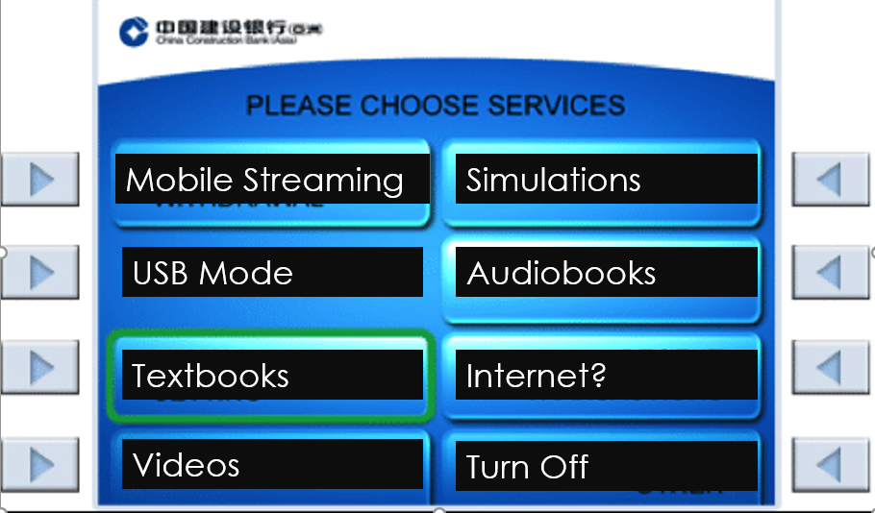
Basic functions
Numbers 1-6 used for selecting mode
After each key is pressed, confirmation message
A-D keys for Select, Delete, Clear choice
Pins 1,4,6,8 for moving page up/down/sideways

Slide 7
Features
Pros:
GUI similar to ATM machines to help user for operating
No requirement of Mouse/ Keyboard
Cons:
Not compatible with internet feature.

